Slide 1








Error Handling and Exceptions
Error Handling in JavaScript, Exceptions, Exception Handling
Errors and Exceptions
SoftUni Team
Technical Trainers
Software University
http://softuni.bg

Slide 2



Table of Contents
Error Handling in JS
Normal Cases, Special Cases, Errors
Exception Handling in JS
Throwing Exceptions
Catching Exceptions
Exceptions vs. Special Values

Slide 3
Have a Question?
sli.do #js-errors

Slide 4
Error Handling in JS

Slide 5
Error Handling – Concepts
In programming, the fundamental principle of error handling says:
In JS, a function failed to do what its name suggests should:
Return a special value (e.g. undefined / false / -1)
Throw an exception / error
A function (method) should either do what its name suggests or indicate a problem.
Any other behavior is incorrect.

Slide 6
Error Handling – Examples
Normal execution → a function does what its name says
Special case → return a special value to indicate "not found"
let str = "Hello, SoftUni";
console.log(str.indexOf("Uni")); // 11
console.log(str.indexOf("")); // 0
let str = "Hello, SoftUni";
console.log(str.indexOf("Sofia")); // -1
console.log(str.indexOf(undefined)); // -1

Slide 7
Error Handling – Exceptions (Errors)
Exception → a function is unable to do its work (fatal error)
let arr = new Array(-1); // Uncaught RangeError
let bigArr = new Array(9999999999); // RangeError
let index = undefined.indexOf("hi"); // TypeError
console.log(asfd); // Uncaught ReferenceError
console.print('hi'); // Uncaught TypeError

Slide 8
Error Handling – Special Values
let sqrt = Math.sqrt(-1); // NaN (special value)
let sub = "hello".substring(2, 1000); // llo
// Soft error → substring still does its job: takes all available chars
let sub = "hello".substring(-100, 100); // hello
// Soft error → substring still does its job: takes all available chars
let inv = new Date("Christmas"); // Invalid Date
let dt = inv.getDate(); // NaN

Slide 9
Unexpected (Not Obvious) Behavior
let d = new Date(2016, 1, 20); // Feb 20 2016 (Jan = 0, Feb = 1)
let dn = new Date(2016, 1, 30); // Mar 01 2016 (next month)
let dp = new Date(2016, -1, 30); // Dec 30 2015 (prev month)
let d1 = new Date(1, 1, 1); // Jan 01 1901
let dMinus1 = new Date(-1, -1, -1); // Nov 29 -2
let pi = new Date(3.14, 3.14, 3.14); // Month / year truncated
// Apr 03 1903 03:21:36 (fractial day turned to hours / minutes)

Slide 10
Problem: Sub-Sum
Write a JS function to sum a range of elements from array
This is a sample solution:
subsum([10, 20, 30, 40, 50, 60], 3, 4)
90
function subsum(arr, startIndex, endIndex) {
let sum = 0;
for (let i = startIndex; i <= endIndex; i++)
sum += arr[i];
return sum;
}

Slide 11
Problem: Sub-Sum – Error Handling
Think about the special cases:
subsum([10, 20, 30, 40, 50, 60], 3, 300)
150
subsum([1.1, 2.2, 3.3, 4.4, 5.5], -3, 1)
3.3
subsum([10, 'twenty', 30, 40], 0, 2)
NaN
subsum([], 0, 0)
subsum([], 1, 2)
0
subsum('text', 0, 2)
subsum({}, 0, 2)
NaN

Slide 12
Solution: Sub-Sum (with Error Handling)
function subsum(arr, startIndex, endIndex) {
if (!Array.isArray(arr))
return NaN;
if (startIndex < 0)
startIndex = 0;
if (endIndex > arr.length - 1)
endIndex = arr.length - 1;
let sum = 0;
for (let i = startIndex; i <= endIndex; i++)
sum += Number(arr[i]);
return sum;
}
explicit error handling / special case handling
Check your solution here: https://judge.softuni.bg/Contests/344

Slide 13




Exception Handling in JS
Throwing Errors / Catching Errors

Slide 14


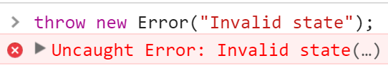
Throwing Errors (Exceptions)
General error
throw new Error("Invalid state");
Value out of range
throw new RangeError("Invalid index");
Expected a different type
throw new TypeError("String expected");
Accessing non-existing object
throw new ReferenceError("Missing age");

Slide 15
Custom Error Class
class StudentNotFoundError extends Error {
constructor(message) {
super(message);
this.name = this.constructor.name;
}
}
Error
StudentNotFoundError
let err = new StudentNotFoundError(
"Student #33 was not found in the database.");
throw err; // StudentNotFoundError: Student #33 was …

Slide 16
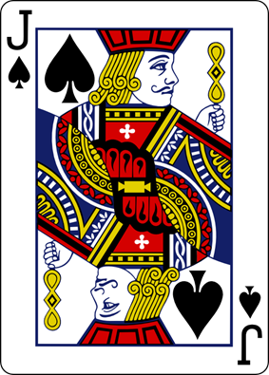
Problem: Playing Cards
Create a class Card to hold card face + card suit
Valid card faces are: 2, 3, 4, 5, 6, 7, 8, 9, 10, J, Q, K, A
Valid card suits are: S (♠), H (♥), D (♦), C (♣)
Throw an error in case of invalid face or suit
console.log('' + new Card('A', 'S')); // A♠
console.log('' + new Card('10', 'H')); // 10♥
console.log('' + new Card('2', 'D')); // 2♦
console.log('' + new Card('1', 'C')); // Error
console.log('' + new Card('4', 'W')); // Error

Slide 17
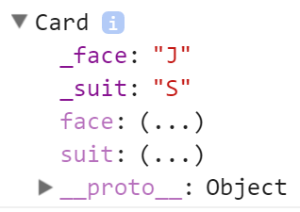
Solution: Playing Cards – Card Class
class Card {
constructor(face, suit) {
this.face = face;
this.suit = suit;
}
get face() { return … }
set face(face) { … }
get siut() { return … }
set suit(suit) { … }
toString { return … }
}

Slide 18
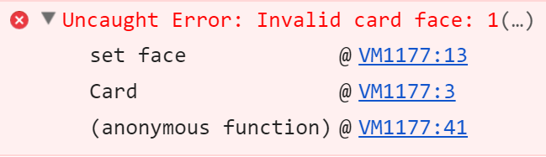
Solution: Playing Cards – Face Getter / Setter
get face() { return this._face; }
set face(face) {
const validFaces = ['2', '3', '4', '5', '6', '7', '8', '9', '10', 'J', 'Q', 'K', 'A'];
if (!validFaces.includes(face))
throw new Error("Invalid card face: " + face);
this._face = face;
}

Slide 19
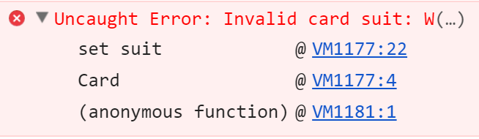
Solution: Playing Cards – Suit Getter / Setter
get suit() { return this._suit; }
set suit(suit) {
const validSuits = ['S', 'H', 'D', 'C'];
if (!validSuits.includes(suit))
throw new Error("Invalid card suit: " + suit);
this._suit = suit;
}

Slide 20
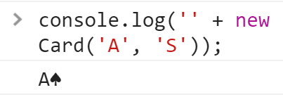
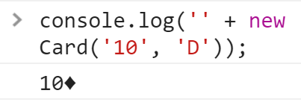
Solution: Playing Cards – toString()
toString() {
let suitToChar = {
'S': "\u2660", // ♠
'H': "\u2665", // ♥
'D': "\u2666", // ♦
'C': "\u2663", // ♣
};
return this.face + suitToChar[this.suit];
}
Check your solution here: https://judge.softuni.bg/Contests/344

Slide 21
List of Cards: Example
Use try-catch block to catch errors (exceptions)
If an error occurs, the control is passed to the catch section
try {
// code that can throw an exception
// some other code → not executed in case of error!
} catch (ex) {
// this code is executed in case of exception
// ex holds the info about the exception
}

Slide 22
Exceptions and Their Properties
try {
throw new RangeError("Invalid range.");
console.log("This will not be executed.");
} catch (ex) {
console.log("---------------");
console.log("Exception object: " + ex);
console.log("Type: " + ex.name);
console.log("Message: " + ex.message);
console.log("Stack: " + ex.stack);
console.log("---------------");
}

Slide 23
Problem: Print Deck of Cards
Write a method to take a deck of cards (each given as string) and print them as sequences of cards (space separated)
Print "Invalid card: [card]" when invalid card is passed as input
printDeckOfCards(['AS', '10D', 'KH', '2C']);
// A♠ 10♦ K♥ 2♣
printDeckOfCards(['5S', '3D', 'QD', '1C']);
// Invalid card: 1C
printDeckOfCards(['3D', 'JC', '2S', '10H', '5X']);
// Invalid card: 5X

Slide 24
Solution: Print Deck of Cards
function printDeckOfCards(cards) {
let deck = [];
for (let cardStr of cards) {
let face = cardStr.substring(0, cardStr.length-1);
let suit = cardStr.substr(cardStr.length-1, 1);
try {
deck.push(new Card(face, suit));
}
catch (err) {
console.log("Invalid card: " + cardStr);
return;
}
}
console.log(deck.join(' '));
}
Insert the class Card here before submission in judge
This can throw an error (when the card is invalid)
Check your solution here: https://judge.softuni.bg/Contests/344

Slide 25


Exceptions vs. Special Values
special
value

Slide 26
Exceptions vs. Special Values
Return a special value for expected behavior
Return a value if no problem / a recoverable problem occurs
Valid input arguments → return valid value or special value
E.g. searching something → return the item found or undefined
Thrown an exception for unexpected behavior
When unrecoverable problem occurs
Invalid input arguments / invalid object state / missing resource
E.g. create a card "-2 hearts" or create array of -5 elements

Slide 27
Problem: Time Span
Create a class TimeSpan to hold hours + minutes + seconds
Internally keep the value in seconds
Return value like "7:08:05" from toString() method
Accept negatives and overflows (e.g. 76 minutes or -5 seconds)
Throw an exception for invalid hours / minutes / seconds
console.log('' + new TimeSpan(7, 8, 5)); // 7:08:05
console.log('' + new TimeSpan(12, 76, -5)); // 13:15:55
console.log('' + new TimeSpan('', 2.5, {})); // Error

Slide 28
Solution: TimeSpan Class – Constructor
class TimeSpan {
constructor(hours, minutes, seconds) {
if (!Number.isInteger(hours))
throw new RangeError("Invalid hours: " + hours);
if (!Number.isInteger(minutes))
throw new RangeError("Invalid minutes: " + minutes);
if (!Number.isInteger(seconds))
throw new RangeError("Invalid seconds: " + seconds);
this._seconds =
seconds + 60 * minutes + 60 * 60 * hours;
}

Slide 29
Solution: TimeSpan Class – toString()
toString() {
let seconds = this._seconds % 60;
let minutes = Math.trunc(this._seconds / 60) % 60;
let hours = Math.trunc(this._seconds / (60 * 60));
seconds = ("0" + seconds).slice(-2);
minutes = ("0" + minutes).slice(-2);
return `${hours}:${minutes}:${seconds}`;
}
}
Check your solution here: https://judge.softuni.bg/Contests/344

Slide 30

Practice: Error Handling and Exceptions
Live Exercises in Class (Lab)

Slide 31


Summary
JS functions should do what their name says
In case of problem:
Return a special value (e.g. undefined / false / -1 / 0 / NaN)
Throw an exception / error
Return a special value for recoverable errors
E.g. missing element / character
Throw an exception for unrecoverable errors
E.g. resource unavailable, invalid operation

Slide 32









Error Handling and Exceptions
https://softuni.bg/courses/javascript-advanced

Slide 33
License
This course (slides, examples, demos, videos, homework, etc.) is licensed under the "Creative Commons Attribution-NonCommercial-ShareAlike 4.0 International" license

Slide 34






Free Trainings @ Software University
Software University Foundation – softuni.org
Software University – High-Quality Education, Profession and Job for Software Developers
softuni.bg
Software University @ Facebook
facebook.com/SoftwareUniversity
Software University @ YouTube
youtube.com/SoftwareUniversity
Software University Forums – forum.softuni.bg

